Slide 1
QuaranTeam 2
Lukas Coffey, Drew Klaubert, David Parks, Arthur Presnetsov
20 April 2020

Slide 2
GOALS
Predict if particular counties or regions will be able to meet the capacity of care.
Design strategies that could be used to ensure that adequate care is provided across the state of Maryland.

Slide 3
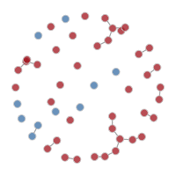
TOOLS
EpiModel provides tools for simulating and analyzing mathematical models of infectious disease dynamics.
Kepler is a geospatial data analysis tool that we’ve used to help us locate high-risk and highly infected counties in Maryland.
R and Rstudio, Python and Jupyter Notebook.

Slide 4
COVID-19 DISEASE RATES
Estimated Model Parameters
Reproduction Number (R_{o}): 1.5 ~ 3.5
Overall Fatality Ratio: 1.38% (adjusting for demography and under-ascertainment)
Recovery Time: 24.7 days
Hospitalization Rate: 4%
Activity Rate: # of transmissive acts per person per day
log₁₀(pop_density) per county
Time steps: 90 days

Slide 5
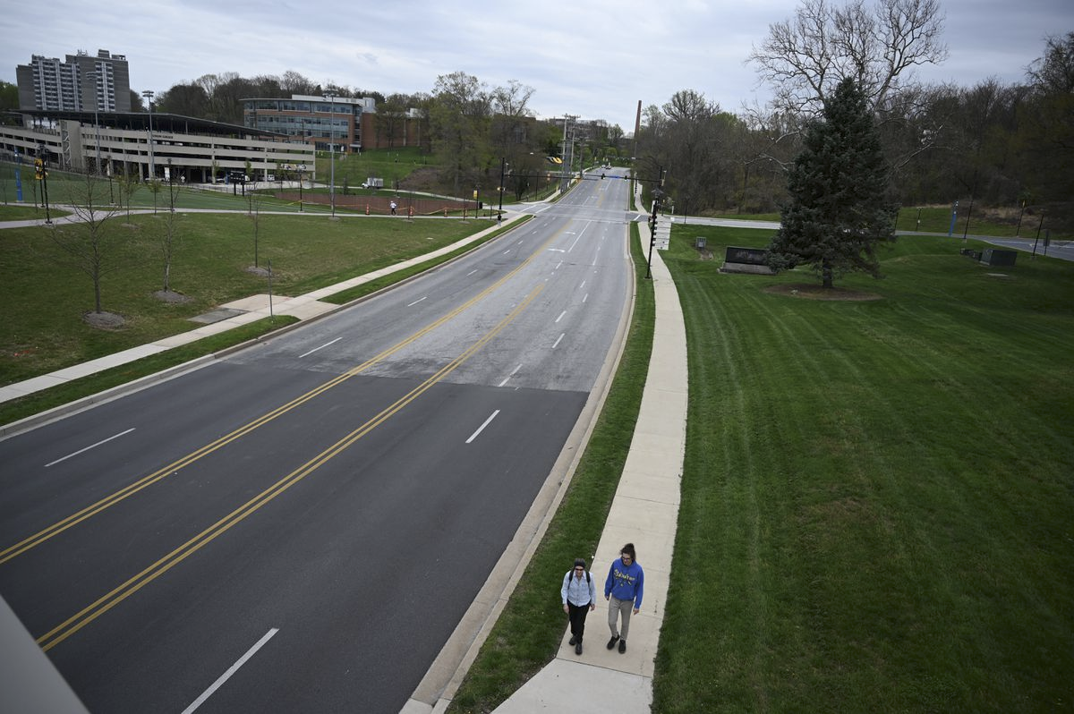
SCENARIOS
No intervention
“Business as usual”
Intervention
Simulating statewide stay-at-home order plus enhanced hygiene practices
Basically our current “social distancing” strategy
Towson, Maryland – The Baltimore Sun

Slide 6
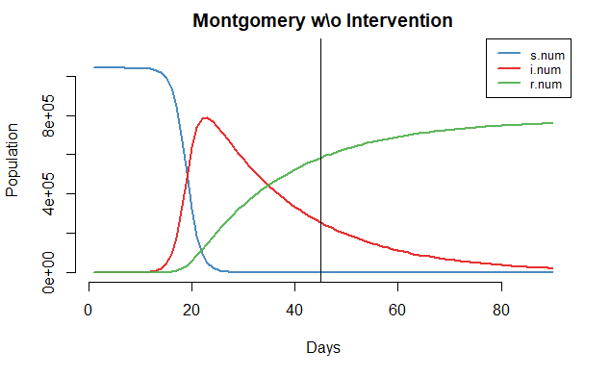
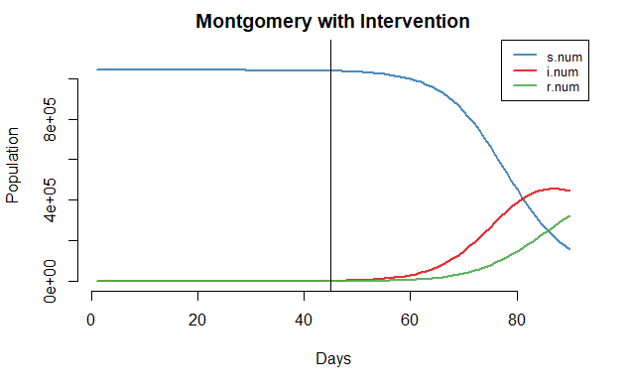
FLATTENING THE CURVE
These plots show the number of susceptible (s.num), infected (i.num), and recovered (r.num) people in Montgomery county over two 90-day simulations, each starting with one infected person on day one. The vertical line denotes day 45, which approximates the number of days since Maryland confirmed its first COVID-19 case on March 4, 2020.
Intervention dramatically decreases the peak of the infection curve and the total number of infected, reducing the overall burden on the healthcare system.

Slide 7
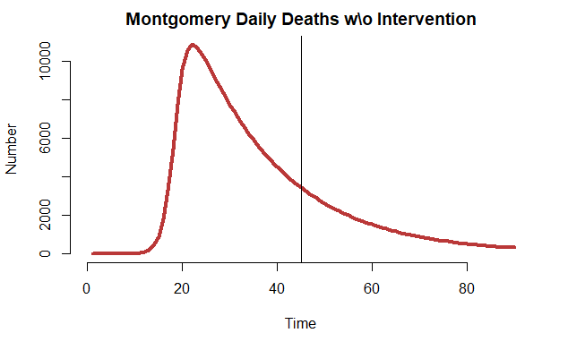
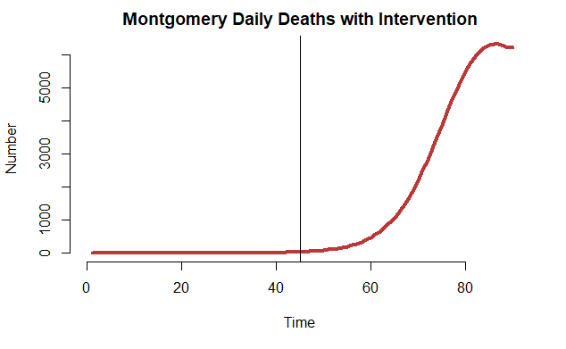
EFFECT ON MORTALITY
These plots show the number of daily deaths in Montgomery county over two 90-day simulations, each starting with one infected person on day one. The vertical line denotes day 45, which approximates the number of days since Maryland confirmed its first COVID-19 case on March 4, 2020.
Intervention decreases the total number of fatalities and gives mortuary service providers time to prepare for the increasing workload.

Slide 8
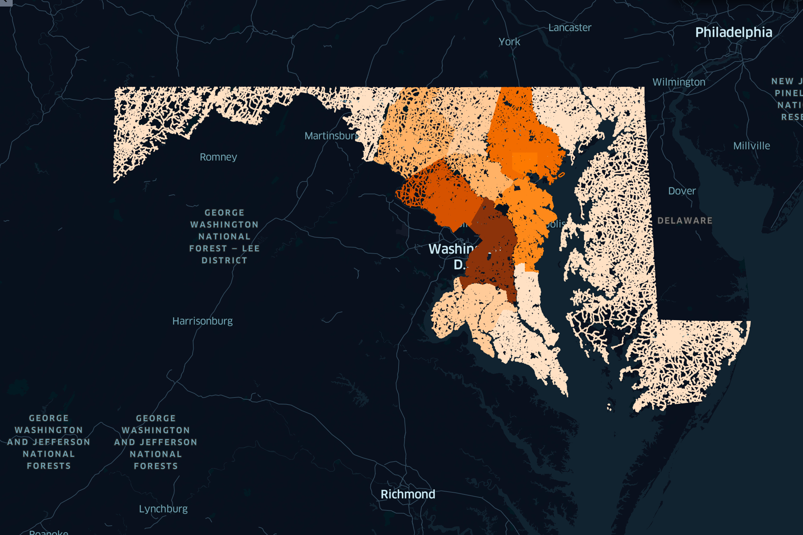

0-250
COVID-19 Cases by County
1750-2000
3500+

Slide 9
2
3
2
2
2
1
7
1
3
18
1
8
2
0
0-250
COVID-19 Cases by County with
# of Hospitals
Overlaid
0
7
1
1750-2000
1
1
3
3
1
1
3500+
1

Slide 10
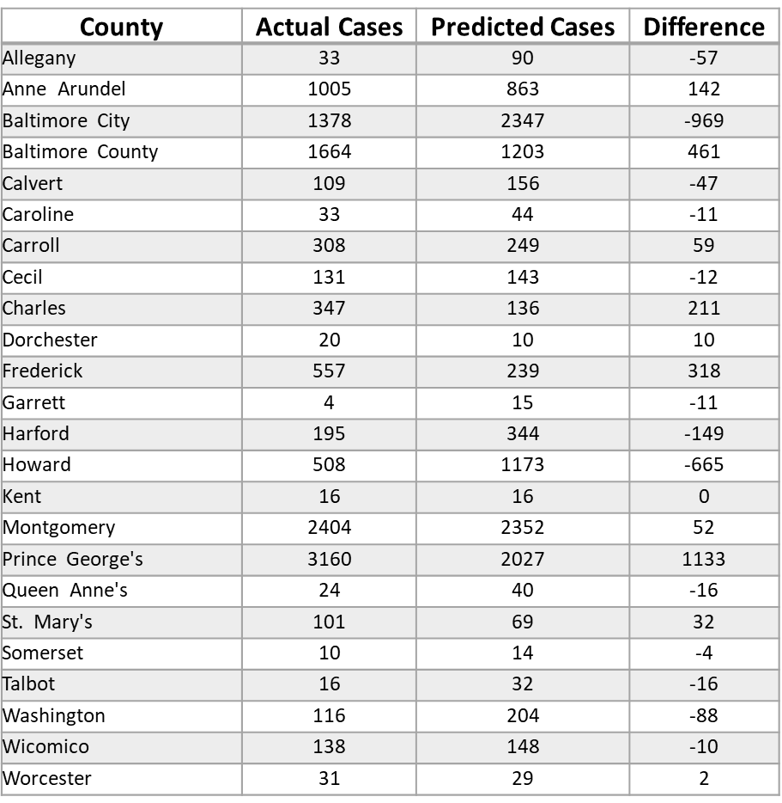
MODEL ACCURACY
This table compares the number of confirmed cases in Maryland on April 18, 2020 – approximately 45 days since the first confirmed case in the state on March 4, 2020 – with the number of predicted cases 45 days since the start of the model simulation with intervention.
Most of the variation can probably be explained by the change in commuting patterns during the statewide stay-at-home order.
For example, the model over-predicted the number of cases in Baltimore City, but absent the daily commuter population, the probability of transmission greatly declines.
Whereas many Prince George’s county residents provide essential services to the capital and cannot work from home, increasing their risk of transmission.
Improvements to the model would need to consider the unique network and temporal interactions of the population, which is a current topic of academic research.
Predictions for the 45th day since the first confirmed infection versus confirmed cases in Maryland approximately 45 days since the first confirmed case on March 4, 2020.

Slide 11
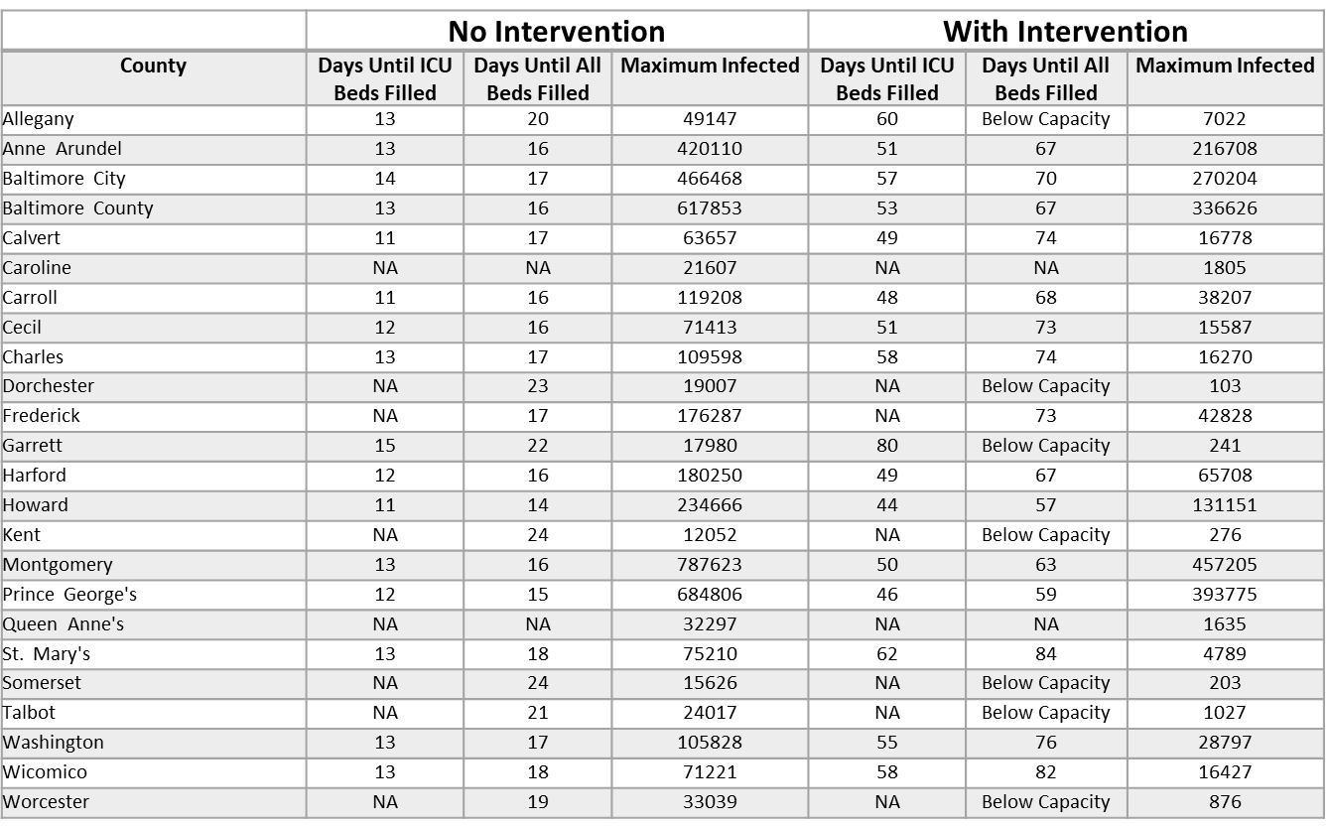
EFFECTS OF INTERVENTION
This table shows the number of days it takes to fill the ICU and inpatient hospital beds in each county without intervention and with intervention.
It also shows the maximum number of infected persons per scenario.
Maryland’s statewide stay-at-home order reduced the transmissivity rate by approximately 72%.

Slide 12
RECOMMENDATIONS
Short-term
There are increasing case numbers in high population counties, so counties with lower case numbers and more healthcare resources could ideally send skilled nurses/physicians to assist in the high-risk counties.
These healthcare providers should be compensated for the extra work and travel.
National Guard forces could be deployed systematically to support COVID-19 negative patients in counties with low risk and less need for skilled nursing/physician care.
Long-term
Focus on continued distancing practices and slow reintegration of gatherings.
Plan for the inevitable surge of cases.
Designate overflow hospitals/floors that are prepared for isolating COVID-19 positive patients.
Having a plan in place to move the negative patients to “safe” hospitals, and move positive patients to the overflow hospitals will allow for a rapid response to a sudden surge in positive cases.
For example: Harford and Carroll counties have 2 hospitals. Baltimore and Baltimore City counties will have significantly more cases and more hospitals, and so patients that are COVID-19 negative could be moved to the ”quieter” hospitals in Harford and Carroll in the event of a sudden surge in hospitalizations.

Slide 13
REFERENCE
Slide 3
Jenness SM, Goodreau SM and Morris M. EpiModel: An R Package for Mathematical Modeling of Infectious Disease over Networks. Journal of Statistical Software. 2018; 84(8): 1-47.
Kepler (https://kepler.gl/)
Slide 4
https://www.thelancet.com/journals/laninf/article/PIIS1473-3099(20)30243-7/fulltext
Slide 5
https://www.baltimoresun.com/maryland/baltimore-county/towson/cng-tt-coronavirus-streets-towson-pg-20200415-baob2hrv4fgknc6uac6nddwmbe-photogallery.html
Slide 9
https://coronavirus.maryland.gov/

